Slide 1
Protecting Seniors from Identity Theft, Scams and Elder Abuse
A Public Service Presentation provided by the Society of Certified Senior Advisors® (SCSA)

Slide 2
This Presentation will cover:
Identity Theft
What it is, how it happens, prevention, and actions to take after your identity has been stolen
Scams
Types of scams, situations to avoid, at-risk activities, targets, perpetrator’s intentions
Caregiver Abuse and Family Perpetrators
Signs to watch for, prevention tips victims resources

Slide 3
What is Identity Theft?
Identity Theft is when someone pretends to be someone else by assuming that person's identity, typically in order to access resources or obtain credit and other benefits in that person's name.
Identity theft occurs when someone uses another's personally identifying information, like their name, social security number, or credit card number, without their permission, to commit fraud or other crimes.

Slide 4
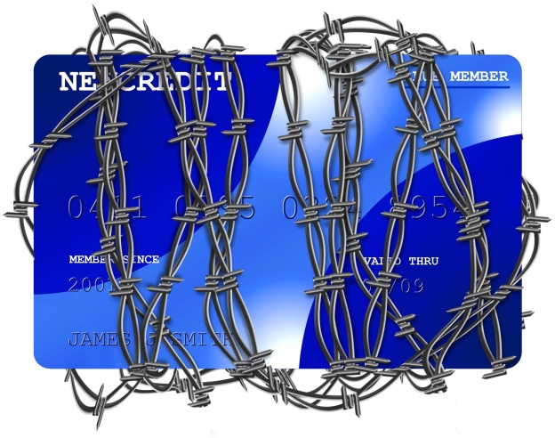
What Identity Thieves Want from You
You full legal name
Social Security Number (Medicare ID Number)
Date of Birth
Address
Credit Card Numbers
Bank Account Numbers
Driver’s License
Passwords
Family Relationship Information
Professional Licenses
Business Identity
Military History/Benefits
Tax Refunds
Your Good Name and Reputation

Slide 5
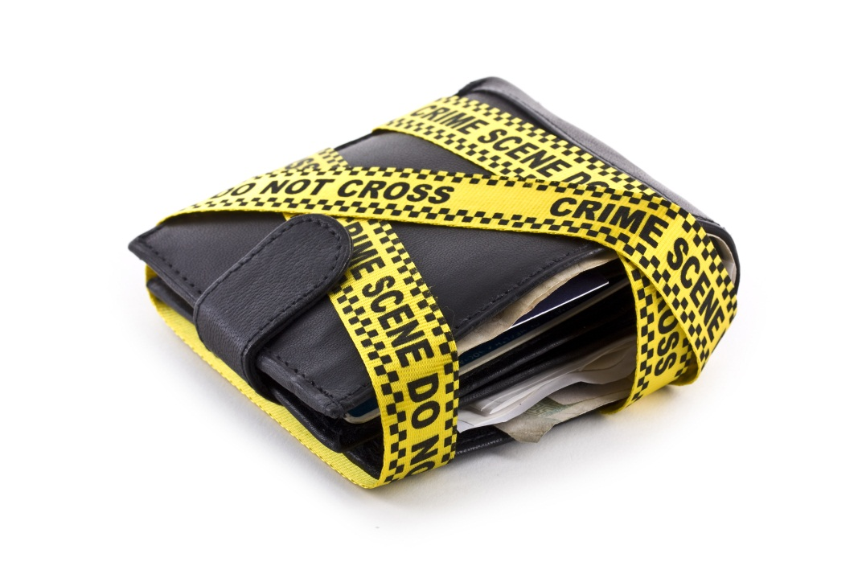
What are the types of Identity Theft?
Financial
Criminal
Social Security/Driver’s License
Medical
Synthetic

Slide 6
Financial Identity Theft
Occurs when thieves gain access to credit card, debit card, or bank account information
Try and drain the victims funds from their accounts, or utilize their credit/debit cards to purchase goods for themselves or for re-sale.
Every year approximately 15 million Americans are victims of ID theft, the average victim’s financial loss is $3,500 and expends approximately 25 hours to recover from the ramifications of the theft (www.identitytheftinfo.com)

Slide 7
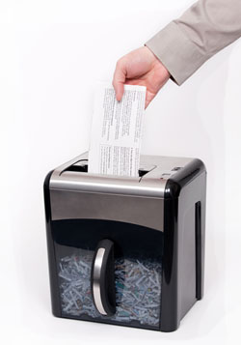
Protecting Against Financial Identity Theft
Run a regular credit report
Opt-out of solicitations when possible
Opting out of pre-screened credit card offers can greatly reduce your risk. Do so at 1-888-5OPTOUT (1-888-567-8688) Or visit www.OptOutPreScreen.com.
Utilizing direct mail makes you more vulnerable to identity theft
Suspending mail delivery during vacations, using a P.O. Box, shredding mail and utilizing online bill pay and direct deposit options can greatly reduce risk
Shred, Shred, Shred
Do not throw away personal/financial information – always shred

Slide 8
Protecting Against Financial Identity Theft
Limit the information you carry in your purse/wallet
Only carry information/documentation that you need daily
Protect your home
Traditional methods of theft still exist – lock information in a safe place and be mindful of who you allow into your home
Annually review your information to ensure nothing is missing
Internet Security
Be mindful of “phishing scams”
Never trust an unsolicited email requesting your personal information
Never click on a link in a phishing email
Run a virus scan regularly
Clear your “cookies” regularly
Protect Yourself – Value Your Personal Information

Slide 9
Medical Identity Theft
Thieves want access to your medical benefits
Very dangerous – causes discrepancies in medical history and you can receive the incorrect treatment
You become fiscally responsible for someone else's medical/pharmaceutical bills
Denial of insurance claims and coverage when you need them most
Protect yourself by monitoring your medical records
Pay special attention to the details on bills and invoices

Slide 10
Criminal Identity Theft
Thieves use your identity to commit crimes and damage your reputation
It is very difficult to convince law enforcement that it was not actually you who committed the crime
Victims usually only learn their identity has been stolen when:
They are arrested from an outstanding warrant
A background check reveals criminal activity in their name

Slide 11
Social Security/Driver’s License Identity Theft
Social Security
Thieves use your Social Security and name to secure real jobs
You become responsible for the taxes owed off a job someone else is working
Thieves use your Social Security number to:
Open lines of credit and participate in other financial identity theft
Participate in “Synthetic” Identity Theft
Driver’s License
Having both your Social Security number and driver’s license information makes stealing your identity much easier

Slide 12
Synthetic Identity Theft
Thieves create an entirely new identity using your Social Security number
They combine different biographical information and a different name in conjunction with your Social Security number
Very difficult to detect since only “bits and pieces” of your identity has been stolen
Warning Signs:
Mail sent to your home addressed to someone else
Inflated annual earnings
Unexpected denial of credit/loan

Slide 13
Scams
Scam artists are criminals – it is not your fault or your lack of judgment for falling victim to a scam
As a senior, you are often targeted for scams because you are:
Often unaware of the trends scam artists are using
More inclined to use postal mail
Generous
More trusting
Remember scam artists are career criminals who practice their craft!

Slide 14
Scams
Things all adults (seniors especially) should remember:
You are not the winner of a contest, especially one you did not enter
Your loved one is not stranded and in need of money to get home
Your grandchild has not been arrested
The soldier does not need your assistance to get home
Wiring money to and from is not a legitimate work from home job
You are not the relative of royalty in a country you cannot find on a map, and no you are not entitled to any inheritance from that country

Slide 15
Scams
If you owe money on a loan you will not be arrested for non-payment
Charities do not actually need your social security number to accept your donation – they do not have to report that to anyone for tax purposes
If a business is legitimate they will send written documentation
Wiring money to Nigeria will not help bring a dog home from Afghanistan.
Many pet lovers become subject to scams by appealing to their willingness to save animals

Slide 16
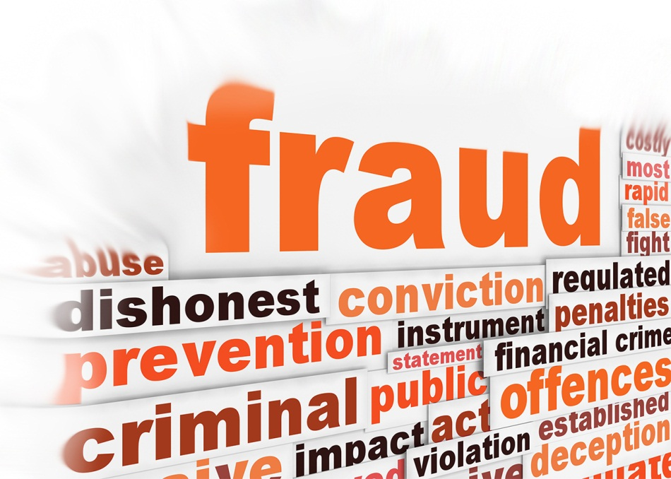
Types of Scams
Cyber Scams
Scam artists often use “phishing” scams to retain your personal information
Dropping viruses
Tricking you to providing them with the information they need
Romance Scams
Users of relationship/dating websites (especially faith based and older adult sites) are especially targeted by criminals
Users are more trusting
Identify with a shared feeling of loneliness and open up faster

Slide 17
Types of Scams
Perpetrators take on very empathetic roles:
Widows/widowers
Soldiers/Veterans
Recovering from a medical condition
The relationship starts out perfect – they appear as though they are your soul mate
You fall in love, and suddenly the scam artist becomes desperate for your help and needs your money to:
Come see you
To get out of a bad situation
Get home while stranded
When you refuse to give money, or stop giving money the relationship becomes threatening and verbally abusive

Slide 18
Types of Scams
Victims have been known to cash in investments and have even lost their homes or retirement savings in order to provide for their new “love”
Medicare Scams
Seniors receive offers for free diabetes testing equipment, back braces, arthritis mediations, etc.
Solicitor pretends they are calling directly from Medicare
Try and get you to provide your Medicare ID number (which is the same as your social security number)
Lure you in with free medical supplies/medications

Slide 19
Types of Scams
Home Improvement/Contractor Scams
Appear legitimate: trucks with company information, equipment, uniforms, etc.
Show up claiming to have extra materials from a nearby job
Often appear after a major storm or disaster to provide relief
Promise a large scope of work, way below the cost an actual contractor could or would do
May appear as they are really working
Bringing materials
Moving things from one place to another
Doing minimal work to make it appear as though a real job was done

Slide 20
Types of Scams
Some scams they are only interested in getting money from you
Money to purchase more materials
Labor expenses for work you think they have done
Other times they are really only interested in access to your home
Bringing an unexpected guest with them to the job (girlfriend, parent, child, etc.) is a major warning sign
They will distract you while their companion steals your information or belongings

Slide 21
Types of Scams
They will try to talk their way into your home
Using the bathroom, getting a drink of water, asking to use the phone are all common excuses
Even if you refuse sometimes they will physically force their way into your home
Scam artists can come in many forms
Some are individuals looking to make a quick buck
Others are part of known organizations and can be very deceiving and convincing
Always protect yourself, personal information and assets
Be cautious of individuals offering goods/services that are too good to be true

Slide 22
Types of Scams
Tax Fraud
Applies to both living and non-living victims
The family of the non-living victim should take immediate action when they learn it is taking place
Criminals will try to file taxes under your name to receive your tax refund
It is a federal crime and must be reported both to the IRS and to your local police department
After reporting, keep in mind that if you owe taxes, you are still subject to penalties if your taxes are not paid on time
You must re-file your taxes which must be done through direct postal mail for 1-3 years, and it will take longer to receive your return (if you are owed one)

Slide 23
Elder Abuse
Family members perpetrate 73% of all reported Elder Abuse Crimes
Family members and professional caregivers have easy access to personal identifying information
Seniors often treat caregivers like family, not like hired professionals
Family members or trusted caregivers are often the agent on a Power of Attorney (POA) – which makes abusing and exploiting a senior much easier

Slide 24
Elder Abuse
Understand what power is given in a POA
Always list 2 parties on a POA for check and balance
Use an attorney or trusted professional if you do not fully trust your family
Give financial institutions permission to refuse any questionable POA
Use a different agent for a Financial POA and a Medical POA
Seniors can be vulnerable to adult children with “Early Inheritance Syndrome”
If possible use professional caregivers – even if family also provides care

Slide 25
Elder Abuse
Keep professional relationships professional
Only use reputable companies that do background checks
Always report abuse or threats of violence
Keep personal information secure when others are in your home
Never provide a caregiver with your ATM card or pin number
Inform several people of who your POA is and who in the family you trust
Access professionals when possible to help in making your financial and care plans

Slide 26
Elder Abuse
Plan ahead for:
Long-Term Care
Illness or incapacity
Who can access your accounts
End of life decisions/Funeral arrangements
Dispersing of your estate
Always be Cautious
Question others
Get everything in writing
Never hesitate to report suspicious behavior or abuse

Slide 27
What to Do once Victimized
Seek Help!
Dealing with ID Theft, Fraud, Scams and Abuse is difficult for anyone at any age
Turn to a professional to help assist you the necessary steps
Report the crime
Address damages
Restore your good name and safety
If left unreported the situation will only get worse

Slide 28
Resources for Victims
Identity Theft Resource Center
email Victims@idtheftcenter.org Or call the ITRC Victim Assistance Center Toll Free (888) 400-5530
Financial Crimes Enfoncement Center
Internet Crime Complaint Center - www.ic3.gov
FBI Local Field Office
www.fbi.gov/contact-us
24 Hour ID Theft & Fraud Hotline
1-855-443-3489 (toll free) - Colorado Bureau of Investigation (assistance available for seniors in all states)
Hazel Heckers, Victim Advocate, hazel.heckers@state.co.us
NCEA – National Center on Elder Abuse
www.ncea.aoa.gov
Federal Trade Commission
1-877-382-4357
www.ftc.gov/ftc/contact.shtm

Slide 29
Resources
Hazel Heckers, Victim Advocate with the Colorado Bureau of Investigation
NCEA – National Center on Elder Abuse - www.ncea.aoa.gov
FinCEN – Financial Crimes Enforcement Network www.fincen.gov
www.caregiverstress.com
www.identitytheft.info/nonprofit

